Slide 1

ISO
14001:2015
COURSE SLIDES · WSQ
ISO 14001:2015 Internal Auditor Training
WSQ Course Code: TGS-2025054479 · 2-Day Instructor-Led Training
Skills Framework TSC: Internal Audit Engagement Planning (ACC-IAD-3005-1.1)
Conducted by Tertiary Infotech Academy Pte Ltd · UEN: 201200696W
Version v5 · 17 August 2026
© 2026 Tertiary Infotech Academy Pte Ltd. All rights reserved. · www.tertiarycourses.com.sg

Slide 2
COURSE ADMINISTRATION
Welcome & Housekeeping
ISO 14001-2015 Internal Auditor Training · TGS-2025054479
© 2026 Tertiary Infotech Academy Pte Ltd
2

Slide 3
TRAQOM · SSG DIGITAL ATTENDANCE
Digital Attendance (Mandatory)
1
2
3
4
5
Trainer displays the SSG digital attendance QR code
Scan the QR with your phone camera
Submit your attendance — AM, PM and Assessment
Repeat on BOTH days of the course
75% minimum attendance for assessment and funding
Digital attendance is mandatory for WSQ-funded courses and is the record SSG uses to determine your funding eligibility.
ISO 14001-2015 Internal Auditor Training · TGS-2025054479
© 2026 Tertiary Infotech Academy Pte Ltd
3

Slide 4
YOUR TRAINER · GENERAL
About the Trainer
NAME
________________________________________________
?
TITLE / DESIGNATION
________________________________________________
QUALIFICATIONS
________________________________________________
Your Trainer
AREAS OF EXPERTISE
________________________________________________
General Trainer template —
to be completed by the trainer
TRAINING & INDUSTRY EXPERIENCE
________________________________________________
CONTACT
________________________________________________
ISO 14001-2015 Internal Auditor Training · TGS-2025054479
© 2026 Tertiary Infotech Academy Pte Ltd
4

Slide 5
YOUR TRAINER
About the Trainer
ROLE
Principal Trainer, Tertiary Infotech Academy Pte Ltd
AA
BACKGROUND
PhD — 20+ years of industry and training experience in management systems, quality and data analytics.
Dr. Alfred Ang
DELIVERS
WSQ courses on ISO management system auditing, quality, sustainability and data science.
Principal Trainer
Tertiary Infotech Academy Pte Ltd
FOUNDER
Founder and lead instructor at Tertiary Infotech / Tertiary Courses.
ISO 14001-2015 Internal Auditor Training · TGS-2025054479
© 2026 Tertiary Infotech Academy Pte Ltd
5

Slide 6
ICE-BREAKER
Let's Know Each Other
• Your name, organisation and role.
• Your experience with ISO 14001, EMS or internal auditing (if any) — and whether your organisation is certified.
• One environmental issue at your workplace you would like to be able to audit confidently by the end of Day 2.
ISO 14001-2015 Internal Auditor Training · TGS-2025054479
© 2026 Tertiary Infotech Academy Pte Ltd
6

Slide 7
HOUSEKEEPING
Ground Rules
Set your mobile phone to silent mode.
Participate actively — no question is too small.
1
2
Mutual respect: agree to disagree.
One conversation at a time.
3
4
Be punctual; return from breaks on time.
75% attendance is required for funding.
5
6
ISO 14001-2015 Internal Auditor Training · TGS-2025054479
© 2026 Tertiary Infotech Academy Pte Ltd
7

Slide 8
COURSE PORTAL · LMS/TMS
Download Course Material
https://lms-tms.tertiaryinfotech.com
Sign in
lms-tms.tertiaryinfotech.com — log in with your registered email.
1
Tertiary Infotech LMS/TMS
My Courses · Attendance · Assessment
Open your course
Select this course under My Courses.
2
ISO 14001:2015 Internal Auditor Training
Trainer Slides (PDF) ⬇
Download materials
Slides, Learner Guide and the activity briefs — your open-book references.
3
Learner Guide (PDF) ⬇
Assessment Submission ↗
Submit & attendance
Submit your assessment answers and scan the digital attendance QR here.
4
All course material is downloaded from the LMS/TMS portal — keep it handy: both assessments are open book.
ISO 14001-2015 Internal Auditor Training · TGS-2025054479
© 2026 Tertiary Infotech Academy Pte Ltd
8

Slide 9
WSQ ALIGNMENT
Skills Framework Alignment
TSC element
Detail
TSC Title
Internal Audit Engagement Planning
TSC Code
ACC-IAD-3005-1.1 · Proficiency Level 1
Knowledge K1
International Professional Practices Framework (IPPF) comprising definitions of Internal Auditing, Code of Ethics, core principles and International Standards for the Professional Practice of Internal Auditing
Knowledge K2
Organisation's significant risks, objectives, resources, operations, businesses and structure
Knowledge K3
Internal audit methodologies and procedures of the organisation
Knowledge K4
Risk identification and assessment techniques
Ability A1
Identify relevant frameworks, guidelines and standards to be applied in the engagement
Ability A2
Identify stages of the engagement and various stakeholders involved
Ability A3
Support conduct of preliminary survey and risk assessment
Every topic, activity and assessment item in this course maps to these TSC knowledge and ability statements.
ISO 14001-2015 Internal Auditor Training · TGS-2025054479
© 2026 Tertiary Infotech Academy Pte Ltd
9

Slide 10
BY THE END OF THIS COURSE
Learning Outcomes
LO1
Identify ISO 14001:2015 standards for internal auditing based on the International Professional Practices Framework (IPPF) and organisational risks
1
LO2
Identify phases of engagement with stakeholders by applying ISO 14001:2015 internal audit methodologies and procedures
2
LO3
Support preliminary risk assessments using risk identification and assessment techniques
3
ISO 14001-2015 Internal Auditor Training · TGS-2025054479
© 2026 Tertiary Infotech Academy Pte Ltd
10

Slide 11
THE JOURNEY
Course Outline — Three Topics Over Two Days
DAY 1 — the standard and the framework
DAY 2 — auditing and risk assessment
• Topic 1 — ISO 14001:2015 Internal Auditor Framework
– Overview of the IPPF
– Introduction to ISO 14001:2015 and the EMS
– Applying ISO 14001:2015 to the organisation — risks, objectives, resources, operations
– Activity 1 — scoping a real engagement
• Topic 2 begins — audit methodologies
• Topic 2 — Auditing ISO 14001:2015
– Phases of auditing and stakeholder engagement
– Activity 2 — audit plan, checklist and interviews
• Topic 3 — Risk Assessment
– Risk assessment · corrective action requests · audit reports
– Activity 3 — risk, CARs and the report
– Final assessment: WA (SAQ) then Case Study
14 hours of facilitation + 2 hours of assessment = 16 hours in total.
ISO 14001-2015 Internal Auditor Training · TGS-2025054479
© 2026 Tertiary Infotech Academy Pte Ltd
11

Slide 12
SCHEDULE · DAY 1
Lesson Plan — Day 1
Time
Session
Method
9:30–9:45
Digital Attendance (AM) · Welcome and course introduction · Trainer…
Admin · Ice-breaker
9:45–11:15
LU1: Introduction to ISO 14001:2015 · T1: ISO 14001:2015 Internal Auditor…
Lecture · Discussion
11:15–11:30
Tea Break
—
11:30–13:15
T1 continued (K1, K2)
Lecture · Worked examples…
13:15–14:00
Lunch Break
—
14:00–15:30
Digital Attendance (PM) · T1 continued — Apply ISO 14001:2015 to the…
Lecture · Case study ·…
15:30–15:45
Tea Break
—
15:45–17:30
LU2: Auditing Methodologies · T2: Auditing ISO 14001:2015 (K3, A2)
Lecture · Discussion
17:30–17:45
Day 1 recap · Q&A · preview of Day 2
Review · Q&A
7 hours of facilitation (9:30 am – 5:45 pm). Digital attendance is taken in the morning and again in the afternoon.
ISO 14001-2015 Internal Auditor Training · TGS-2025054479
© 2026 Tertiary Infotech Academy Pte Ltd
12

Slide 13
SCHEDULE · DAY 2
Lesson Plan — Day 2
Time
Session
Method
9:30–9:45
Digital Attendance (AM) · Day 1 recap
Admin · Review
9:45–11:15
T2 continued — Phases of Auditing (K3, A2)
Lecture · Worked examples
11:15–11:30
Tea Break
—
11:30–13:00
T2 continued — Engagement with Stakeholders (A2) · ACTIVITY 2 — AquaPure…
Case study · Role play ·…
13:00–13:45
Lunch Break
—
13:45–15:30
Digital Attendance (PM) · LU3: Risk Assessment Techniques
Lecture · Worked examples…
15:30–15:45
Tea Break
—
15:45–17:30
T3 continued — Corrective Action and Reporting (K4, A3) · ACTIVITY 3…
Case study · Group work ·…
17:30–17:45
Course summary · Briefing for Assessment · Assessment Digital Attendance ·…
Admin · Briefing
17:45–18:45
FINAL ASSESSMENT — Written Assessment, Short Answer Questions (WA/SAQ) · 4…
Assessment
18:45–19:45
FINAL ASSESSMENT — Case Study (CS) · 3 scenario-based questions covering A1…
Assessment
7 hours of facilitation + 2 hours of assessment (9:30 am – 7:45 pm). Course total: 14 h facilitation + 2 h assessment.
ISO 14001-2015 Internal Auditor Training · TGS-2025054479
© 2026 Tertiary Infotech Academy Pte Ltd
13

Slide 14
BEFORE THE ASSESSMENT
Briefing for Assessment
Phones away
Place phones and all other materials under the table or on the floor.
No recording
No photographs or recording of the assessment scripts.
1
2
Work alone
No discussion with other learners during the assessment.
Black or blue pen
No liquid paper and no correction tape.
3
4
Raise your hand
The assessor will come to you if you have a question.
Time is called
Scripts are collected when the time is up.
5
6
ISO 14001-2015 Internal Auditor Training · TGS-2025054479
© 2026 Tertiary Infotech Academy Pte Ltd
14

Slide 15
FINAL ASSESSMENT
Final Assessment
Written Assessment (SAQ)
4 short-answer questions · 60 minutes · covers K1–K4.
Case Study (CS)
3 scenario-based questions · 60 minutes · covers A1–A3.
1
2
Open book
Slides, Learner Guide, activity briefs and your own notes.
Individual work
Both instruments are completed individually.
3
4
Grading
Competent (C) / Not Yet Competent (NYC) — all answers must be correct to be Competent.
Appeals
An appeal process is available if you disagree with the outcome.
5
6
ISO 14001-2015 Internal Auditor Training · TGS-2025054479
© 2026 Tertiary Infotech Academy Pte Ltd
15

Slide 16
ON ASSESSMENT DAY
Assessment Flow
1
2
3
4
5
TRAQOM — scan the QR code on the LMS
Assessment digital attendance — scan the SSG QR
Sit the WA (SAQ) 1 hr, then the Case Study 1 hr — open book
Submit your answers on the LMS
Sign the Assessment Summary Record
ISO 14001-2015 Internal Auditor Training · TGS-2025054479
© 2026 Tertiary Infotech Academy Pte Ltd
16

Slide 17
ELIGIBILITY
Criteria for WSQ Funding
Attendance
Minimum 75% attendance based on the SSG digital attendance record.
Assessment
Complete both instruments and be assessed as Competent (C).
1
2
TRAQOM
Complete the TRAQOM survey on the LMS.
SkillsFuture Credit
Eligible individuals may use SkillsFuture Credit to offset course fees. See www.skillsfuture.gov.sg.
3
4
ISO 14001-2015 Internal Auditor Training · TGS-2025054479
© 2026 Tertiary Infotech Academy Pte Ltd
17

Slide 18
TOPIC 01
ISO 14001:2015 Internal Auditor Framework
IPPF · the EMS and Annex SL · Clauses 4–10 · aspects, impacts and compliance obligations · risk-based thinking
01
ISO 14001-2015 Internal Auditor Training · TGS-2025054479
© 2026 Tertiary Infotech Academy Pte Ltd
18

Slide 19
WHY WE ARE HERE
An internal audit is not an inspection.
It is a systematic, independent and documented process for obtaining evidence and evaluating it objectively against agreed criteria.
ISO 14001-2015 Internal Auditor Training · TGS-2025054479
© 2026 Tertiary Infotech Academy Pte Ltd
19

Slide 20
THE ROLE
What an Internal EMS Auditor Actually Does
Verifies conformity
Tests the EMS against ISO 14001:2015 AND the organisation's own requirements — clause 9.2.1 requires both.
Tests effectiveness
Not just 'is there a procedure' but 'is it implemented, maintained and working'.
1
2
Gathers objective evidence
Records, documented information, observations and interview responses — never opinion.
Reports to management
Findings go to the people who can act on them, and feed clause 9.3 management review.
3
4
Supports improvement
Findings drive corrective action under clause 10.2 and continual improvement under 10.3.
Stays independent
Auditors do not audit their own work — clause 9.2.2 requires objectivity and impartiality.
5
6
ISO 14001-2015 Internal Auditor Training · TGS-2025054479
© 2026 Tertiary Infotech Academy Pte Ltd
20

Slide 21
K1 · KNOWLEDGE
The International Professional Practices Framework
The professional framework that governs how internal auditors behave and work
1.1
ISO 14001-2015 Internal Auditor Training · TGS-2025054479
© 2026 Tertiary Infotech Academy Pte Ltd
21

Slide 22
FOUR MANDATORY COMPONENTS
The IPPF — Mandatory Guidance
1
Definition of Internal Auditing
2
Code of Ethics
3
Core Principles
4
International Standards
An independent, objective assurance and consulting activity designed to add value and improve an organisation's operations, using a systematic, disciplined approach.
Integrity · Objectivity · Confidentiality · Competency — the rules of conduct that govern auditor behaviour.
The fundamental characteristics of effective internal auditing: integrity, competence, due professional care, objectivity, alignment with strategy, and insight.
The Standards for the Professional Practice of Internal Auditing — attribute standards (who we are) and performance standards (what we do).
THE POINT
All four are MANDATORY. Conformance is required for anyone claiming to practise internal auditing under the IPPF — and each one is examinable in this course.
ISO 14001-2015 Internal Auditor Training · TGS-2025054479
© 2026 Tertiary Infotech Academy Pte Ltd
22

Slide 23
HOW ETHICS SHOWS UP IN AN AUDIT
The Code of Ethics — Four Principles in Practice
Integrity
Perform work with honesty, diligence and responsibility. Do not knowingly be party to any illegal activity.
Objectivity
Maintain an unbiased mental attitude. Do NOT audit an area where you have operational responsibility.
1
2
Confidentiality
Respect the value and ownership of information received; do not disclose it without authority.
Competency
Apply the knowledge, skills and experience needed. Decline — or get support for — work you are not competent to do.
3
4
ISO 14001-2015 Internal Auditor Training · TGS-2025054479
© 2026 Tertiary Infotech Academy Pte Ltd
23

Slide 24
ISO 14001 CL. 9.2.2 · IPPF OBJECTIVITY
Independence and Objectivity — the Two Failure Modes
✗ IMPAIRED — do not do this
✓ INTACT — this is the standard
• Auditing the department you work in
– Auditing a procedure you personally wrote
– Auditing your own corrective actions from last year
– Accepting gifts or hospitality from the auditee
– Consulting mid-audit: 'what you should do is buy a new bund'
– Being pressured to downgrade a finding
• Auditing a department other than your own
– Declaring any prior involvement before the audit starts
– A second auditor verifies your own area
– Findings graded on evidence, not on how the auditee reacts
– You note the gap; the auditee designs the fix
– Impartiality recorded in the audit plan
Clause 9.2.2 requires the organisation to 'select auditors and conduct audits to ensure objectivity and the impartiality of the audit process'. In a small company, cross-departmental auditing is the usual solution.
ISO 14001-2015 Internal Auditor Training · TGS-2025054479
© 2026 Tertiary Infotech Academy Pte Ltd
24

Slide 25
K1 · KNOWLEDGE
ISO 14001:2015 and the Environmental Management System
What the standard is, how it is structured, and what an EMS is for
1.2
ISO 14001-2015 Internal Auditor Training · TGS-2025054479
© 2026 Tertiary Infotech Academy Pte Ltd
25

Slide 26
THE STANDARD IN ONE SLIDE
What is ISO 14001:2015?
An EMS standard
Specifies requirements for an environmental management system an organisation can use to enhance its environmental performance.
Certifiable
The requirements are auditable; organisations can be certified to it by an accredited certification body.
1
2
No performance levels
The standard does NOT state specific environmental performance criteria — the organisation sets its own.
No exclusions
Unlike ISO 9001, there is no clause-exclusion mechanism. All requirements must be incorporated and fulfilled.
3
4
ISO 14001-2015 Internal Auditor Training · TGS-2025054479
© 2026 Tertiary Infotech Academy Pte Ltd
26

Slide 27
CLAUSE 1 · WHAT THE EMS IS FOR
The Three Intended Outcomes of an EMS
1
Enhancement of environmental performance
2
Fulfilment of compliance obligations
3
Achievement of environmental objectives
The EMS must actually improve how the organisation performs environmentally — not merely document what it already does.
Legal requirements the organisation has to comply with, and other requirements it has to or chooses to comply with.
Objectives set by the organisation, consistent with its environmental policy and its significant environmental aspects.
THE POINT
Every audit finding you write should ultimately connect to one of these three outcomes. If it does not, ask yourself whether it is really a finding.
ISO 14001-2015 Internal Auditor Training · TGS-2025054479
© 2026 Tertiary Infotech Academy Pte Ltd
27

Slide 28
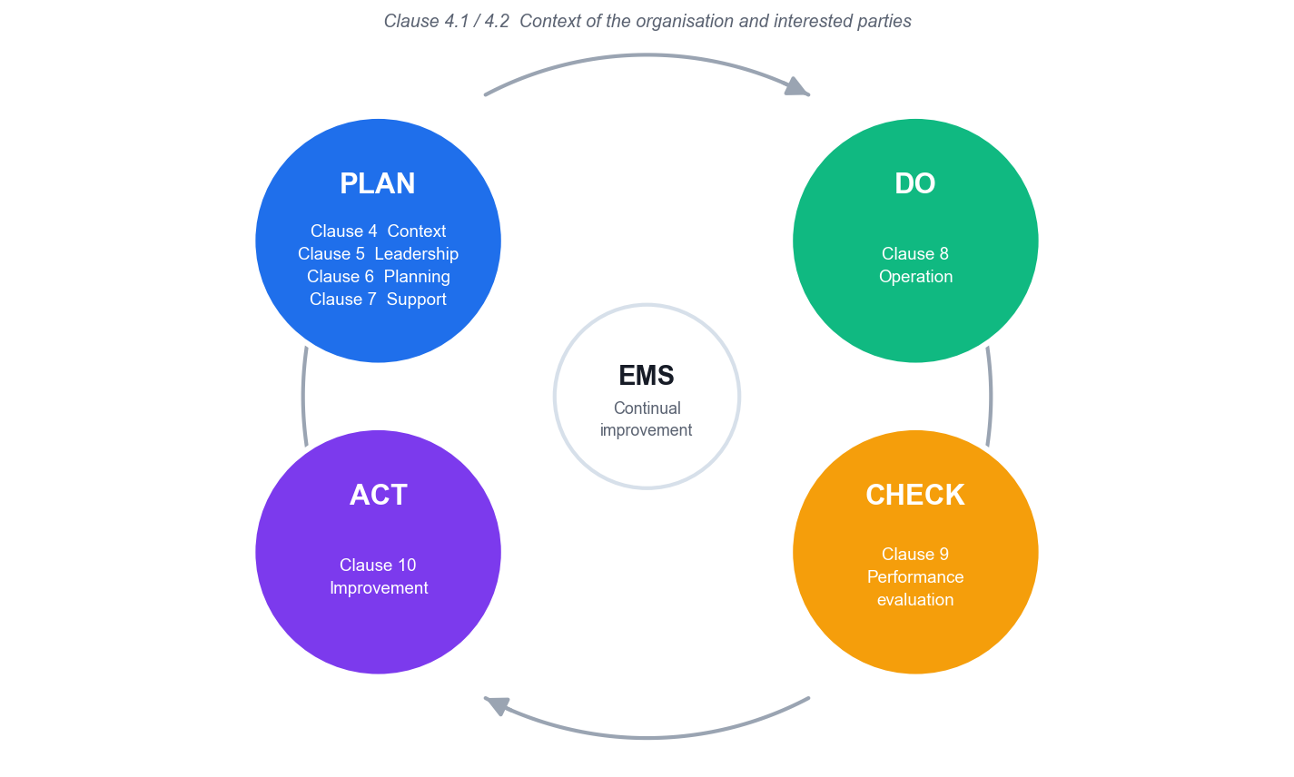
THE STRUCTURE
PDCA — the Engine of the Standard
Plan (clauses 4–7) · Do (clause 8) · Check (clause 9) · Act (clause 10). Context (4.1/4.2) encircles the whole cycle. Continual improvement is the purpose, not a by-product.
ISO 14001-2015 Internal Auditor Training · TGS-2025054479
© 2026 Tertiary Infotech Academy Pte Ltd
28

Slide 29
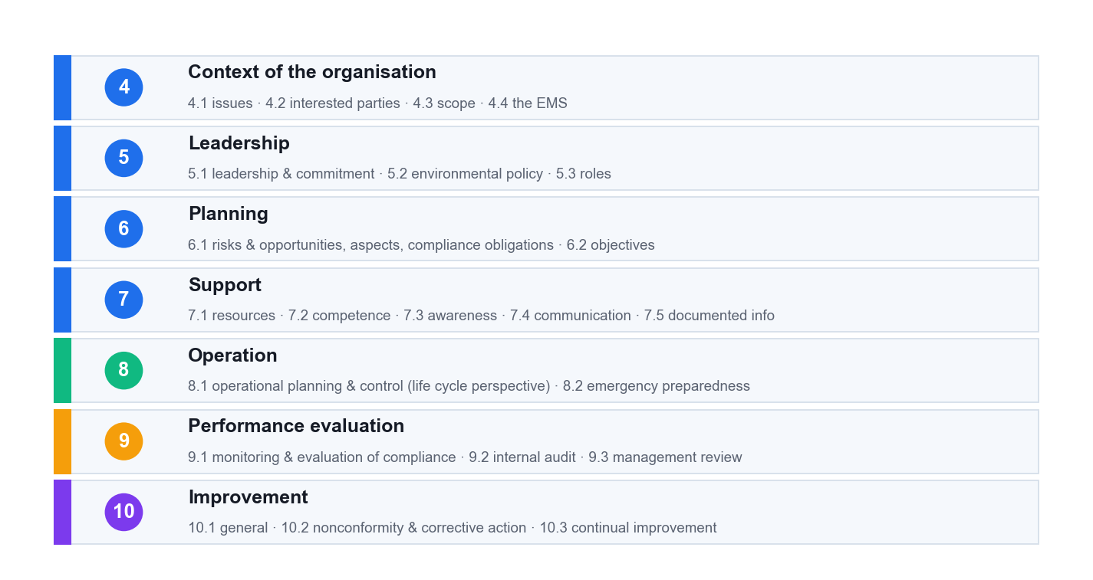
CLAUSES 4–10 · WHAT YOU AUDIT
The 10 Clauses — Annex SL High Level Structure
Clauses 1–3 are Scope, Normative references and Terms. Clauses 4–10 carry every auditable requirement. The identical high level structure is what lets ISO 14001 integrate with ISO 9001 and ISO 45001.
ISO 14001-2015 Internal Auditor Training · TGS-2025054479
© 2026 Tertiary Infotech Academy Pte Ltd
29

Slide 30
READ THE STANDARD LIKE AN AUDITOR
Verbal Forms — What Is Actually Auditable
Form
Meaning
Auditable?
shall
A requirement
YES — non-fulfilment is a nonconformity
should
A recommendation
No — cannot raise an NC against a 'should'
may
A permission
No
can
A possibility or capability
No
ISO 19011 is written entirely in 'should' — it is GUIDANCE. You audit against ISO 14001 clause 9.2, never 'against ISO 19011'.
ISO 14001-2015 Internal Auditor Training · TGS-2025054479
© 2026 Tertiary Infotech Academy Pte Ltd
30

Slide 31
THE 2015 REVISION
What Changed: ISO 14001:2004 → 2015
NEW OR STRENGTHENED
REMOVED OR RENAMED
• Context of the organisation (4.1, 4.2)
– Two-way: the organisation affects the environment AND environmental conditions affect the organisation
• Leadership (5.1) — top management must DEMONSTRATE leadership
• Risk-based thinking (6.1) — risks and opportunities
• Life cycle perspective (6.1.2, 8.1)
• Environmental performance emphasis (9.1.1, 10.3)
• Preventive action — DELETED
– The whole of clause 6.1 IS the preventive mechanism. Never raise an NC for 'no preventive action procedure'
• Management representative — no longer mandatory
– Duties remain but may be distributed (5.3)
• 'Documents' + 'records' → 'documented information'
• 'Objectives and targets' → 'environmental objectives'
The single most common auditor error on a transitioned EMS: raising a finding for a missing preventive-action procedure or a missing environmental manual. Neither is required by ISO 14001:2015.
ISO 14001-2015 Internal Auditor Training · TGS-2025054479
© 2026 Tertiary Infotech Academy Pte Ltd
31

Slide 32
WHAT YOU AUDIT · CLAUSE 4
Clause 4 — Context of the Organisation
1
4.1 Issues
2
4.2 Interested parties
3
4.3 Scope
4
4.4 The EMS
Determine external and internal issues relevant to the EMS — INCLUDING environmental conditions capable of affecting the organisation. No documented information required.
Determine the parties, their relevant needs, and CRUCIALLY which of those needs the organisation adopts as compliance obligations.
Boundaries and applicability. MUST be maintained as documented information and be available to interested parties.
Establish, implement, maintain and continually improve the EMS including the processes needed and their interactions.
THE POINT
Audit tip: 4.1 and 4.2 require NO documented information. Do not demand a 'context document' — test by interview and by tracing whether context actually shaped the aspects, obligations and objectives.
ISO 14001-2015 Internal Auditor Training · TGS-2025054479
© 2026 Tertiary Infotech Academy Pte Ltd
32

Slide 33
WHAT YOU AUDIT · CLAUSE 5
Clause 5 — Leadership
1
5.1 Leadership and commitment
2
5.2 Environmental policy
3
5.3 Roles and responsibilities
Top management shall DEMONSTRATE leadership: take accountability for EMS effectiveness, integrate EMS requirements into business processes, ensure resources. Non-delegable — interview top management directly.
Commitments to protection of the environment (including prevention of pollution), to fulfil compliance obligations, and to continual improvement. Maintained as documented information; communicated; available to interested parties.
Assigned AND communicated. Specific assignment for EMS conformity and for reporting EMS performance to top management. The 'management representative' is no longer mandatory.
THE POINT
The strongest leadership test is not the signed policy on the wall — it is whether top management can describe the organisation's significant environmental aspects without being prompted.
ISO 14001-2015 Internal Auditor Training · TGS-2025054479
© 2026 Tertiary Infotech Academy Pte Ltd
33

Slide 34
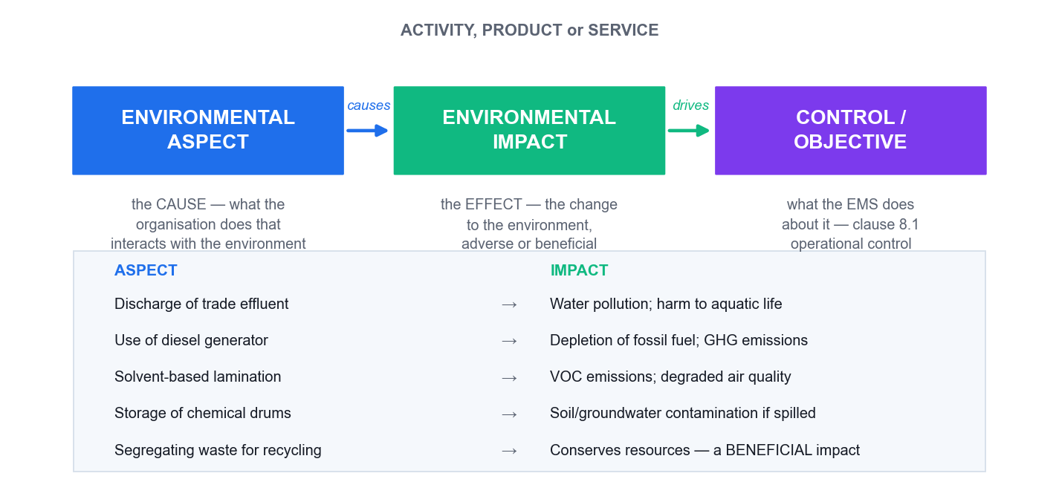
THE CORE CONCEPT OF THE STANDARD
Clause 6.1.2 — Environmental Aspects
Aspect = the CAUSE
The element of your activity that interacts with the environment. You control it.
Impact = the EFFECT
The change to the environment — adverse OR beneficial.
Control AND influence
6.1.2 covers aspects you can control and those you can influence — not just inside the fence.
Criteria decide significance
Determine significant aspects BY USING ESTABLISHED CRITERIA. The criteria are auditable.
The classic register errors: writing 'diesel generator' (that is equipment), or 'pollution' (that is an impact) in the aspect column.
ISO 14001-2015 Internal Auditor Training · TGS-2025054479
© 2026 Tertiary Infotech Academy Pte Ltd
34

Slide 35
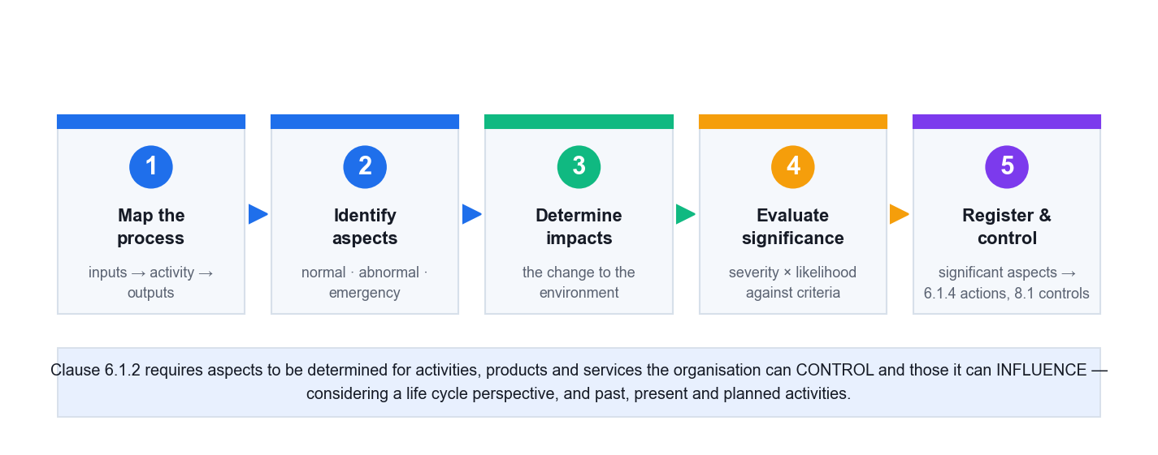
CLAUSE 6.1.2 IN PRACTICE
Determining Aspects — the Required Process
Clause 6.1.2 explicitly requires consideration of CHANGE (including new or modified activities), of ABNORMAL conditions and of REASONABLY FORESEEABLE EMERGENCY situations — and a life cycle perspective.
ISO 14001-2015 Internal Auditor Training · TGS-2025054479
© 2026 Tertiary Infotech Academy Pte Ltd
35

Slide 36
GET THE COLUMNS RIGHT
Aspects and Impacts — Worked Examples
Activity
Environmental ASPECT (cause)
Environmental IMPACT (effect)
PCB washing
Discharge of trade effluent containing copper
Watercourse contamination; toxicity to aquatic life
Solvent lamination
Emission of VOCs from solvent-based adhesives
Air pollution; photochemical smog
Chiller operation
Consumption of grid electricity; HFC refrigerant leakage
Resource depletion; GHG emissions and climate change
Chemical drum storage
Potential release from bund failure (EMERGENCY)
Soil and groundwater contamination
Waste segregation
Recovery of recyclable material
Conserves resources — a BENEFICIAL impact
A register with zero beneficial aspects and zero emergency aspects is a red flag — it usually means the register was copied, not built.
ISO 14001-2015 Internal Auditor Training · TGS-2025054479
© 2026 Tertiary Infotech Academy Pte Ltd
36

Slide 37
WHAT A GOOD REGISTER COVERS
The Three Dimensions of a Complete Aspect Register
Normal
Routine, steady-state operation as designed.
Abnormal
Predictable but non-routine: maintenance, cleaning, changeover, start-up and shut-down — often the WORST emissions per hour.
1
2
Emergency
Reasonably foreseeable: spill, fire, bund failure, power loss. Links directly to clause 8.2.
Past · present · planned
Legacy contamination, current operations, and planned changes — assessed BEFORE the change.
3
4
Direct (control)
Own emissions, own effluent, own waste, own energy.
Indirect (influence)
Supplier practices, contractor behaviour, product use, end-of-life. Omitting these entirely is a common finding.
5
6
ISO 14001-2015 Internal Auditor Training · TGS-2025054479
© 2026 Tertiary Infotech Academy Pte Ltd
37

Slide 38
WHAT YOU AUDIT · CLAUSE 6.1.3
Clause 6.1.3 — Compliance Obligations
1
Legal requirements
2
Other requirements
3
The three duties
What the organisation HAS TO comply with: EPMA and its regulations, EPHA, the Sewerage and Drainage Act, the Resource Sustainability Act, the Carbon Pricing Act, licences and permit conditions.
What it HAS TO or CHOOSES TO comply with: customer contracts, corporate policies, industry codes, agreements with community groups.
(a) determine and HAVE ACCESS TO them; (b) determine HOW THEY APPLY; (c) TAKE THEM INTO ACCOUNT in the EMS. Maintained as documented information.
THE POINT
A bare register of law titles does not meet 6.1.3 — the organisation must have determined HOW each obligation applies to it. That interpretation is what you audit.
ISO 14001-2015 Internal Auditor Training · TGS-2025054479
© 2026 Tertiary Infotech Academy Pte Ltd
38

Slide 39
THE SINGAPORE CONTEXT
Singapore Compliance Obligations — What to Ask For
Regime
Regulator
Evidence an auditor asks to see
Air emissions (EPMA)
NEA
Source emission test reports from an accredited lab; stack/CEMS records; calibration certificates
Trade effluent to SEWER
PUB
Written Approval and its conditions; sampling results; pre-treatment O&M logs
Trade effluent to WATERCOURSE
NEA
Discharge limits (e.g. pH 6–9, TSS 50 mg/L); accredited lab analyses
Toxic industrial waste
NEA
Collector's licence covering THAT waste; e-consignment notes (WRMS); transport approvals
Boundary noise
NEA
Monitoring by a Type 1 meter; calibration certificates; complaint register
Carbon tax
NEA
Registration; Monitoring Plan; verified Emissions Report; calibration records
Hazardous substances
NEA
Hazardous Substances Licence and permits; transaction records; SDS
Verified as at August 2026. Limits, thresholds and rates change — audit the METHOD of maintaining the legal register (6.1.3) and the evaluation of compliance (9.1.2), not just this year's numbers.
ISO 14001-2015 Internal Auditor Training · TGS-2025054479
© 2026 Tertiary Infotech Academy Pte Ltd
39

Slide 40
FIGURES VERIFIED AUG 2026
Verified Singapore Figures — Use With a 'Verified As At' Date
Item
Figure
Source
Carbon tax 2026–2027
S$45 per tCO₂e
NCCS / Carbon Pricing Act
Carbon tax — taxable facility
≥ 25,000 tCO₂e per year
Carbon Pricing Act
Carbon tax — reportable facility
≥ 2,000 tCO₂e per year (report, no tax)
Carbon Pricing Act
Boundary noise — factory, day
75 dB(A) over any 5-min period
EPM (Boundary Noise) Regs
Trade effluent to watercourse
pH 6–9 · TSS 50 mg/L · COD 100 mg/L
NEA
Energy Conservation Act trigger
≥ 54 TJ/yr in 2 of 3 preceding years
ECA 2012
Teach learners to date every figure in a legal register and to re-verify at a defined frequency — that discipline is what clause 6.1.3 and 9.1.2 actually require.
ISO 14001-2015 Internal Auditor Training · TGS-2025054479
© 2026 Tertiary Infotech Academy Pte Ltd
40

Slide 41
THE TWO-WAY TEST
Clause 4.1 — Context Works BOTH Ways
The organisation affects the environment
Emissions, effluent, waste, resource use — the traditional view, and still clause 6.1.2.
The environment affects the organisation
NEW in 2015: 'environmental conditions capable of affecting the organisation'.
1
2
External issues
Regulation, climate, resource scarcity and price, technology, market and competitive pressure, community expectations.
Internal issues
Activities, products and services, strategic direction, culture, capabilities, and planned change.
3
4
Climate change is explicit
The Feb 2024 amendment requires the organisation to determine whether climate change is a relevant issue.
No document required
4.1 mandates no documented information — test whether context actually shaped the aspects, obligations and objectives.
5
6
ISO 14001-2015 Internal Auditor Training · TGS-2025054479
© 2026 Tertiary Infotech Academy Pte Ltd
41

Slide 42
CLAUSE 4.2(C) · THE GATEWAY
How an Interested Party Need Becomes Auditable
1
2
3
4
5
Identify the party
Determine their need
DECIDE — clause 4.2(c)
It becomes an obligation
Audit it
Neighbours, NEA, customers, landlord, employees
What they actually require or expect of you
Which needs the organisation ADOPTS
Now a compliance obligation under 6.1.3
Determined, applied, taken into account, and evaluated at 9.1.2
THE POINT
Not every expectation is a compliance obligation. A customer request becomes one the moment it is written into a contract the organisation signs — or the organisation otherwise chooses to comply. That decision point is exactly what you audit.
ISO 14001-2015 Internal Auditor Training · TGS-2025054479
© 2026 Tertiary Infotech Academy Pte Ltd
42

Slide 43
TAKE THESE ON SITE
Identifying Aspects — Four Methods That Actually Work
Method
How it works
What it catches
Process mapping
Flowchart each step, interrogate each for interaction
Aspects inside repeatable production processes
Input–output analysis
Materials, water, energy, chemicals IN → product, emissions, effluent, waste OUT
The MASS BALANCE gap — 'you bought 500 L of solvent and disposed of 120 L. Where did the rest go?'
Site walkthrough
Walk the drains, stacks, vents, bunds, skips, storage areas
The informal and undocumented — the unbunded drum behind the workshop
Life cycle stages
Raw materials → design → production → transport → use → end of life
Indirect aspects outside the fence that a register often misses
The mass-balance question is the single most productive aspect-audit technique: unaccounted input is almost always an unregistered fugitive emission.
ISO 14001-2015 Internal Auditor Training · TGS-2025054479
© 2026 Tertiary Infotech Academy Pte Ltd
43

Slide 44
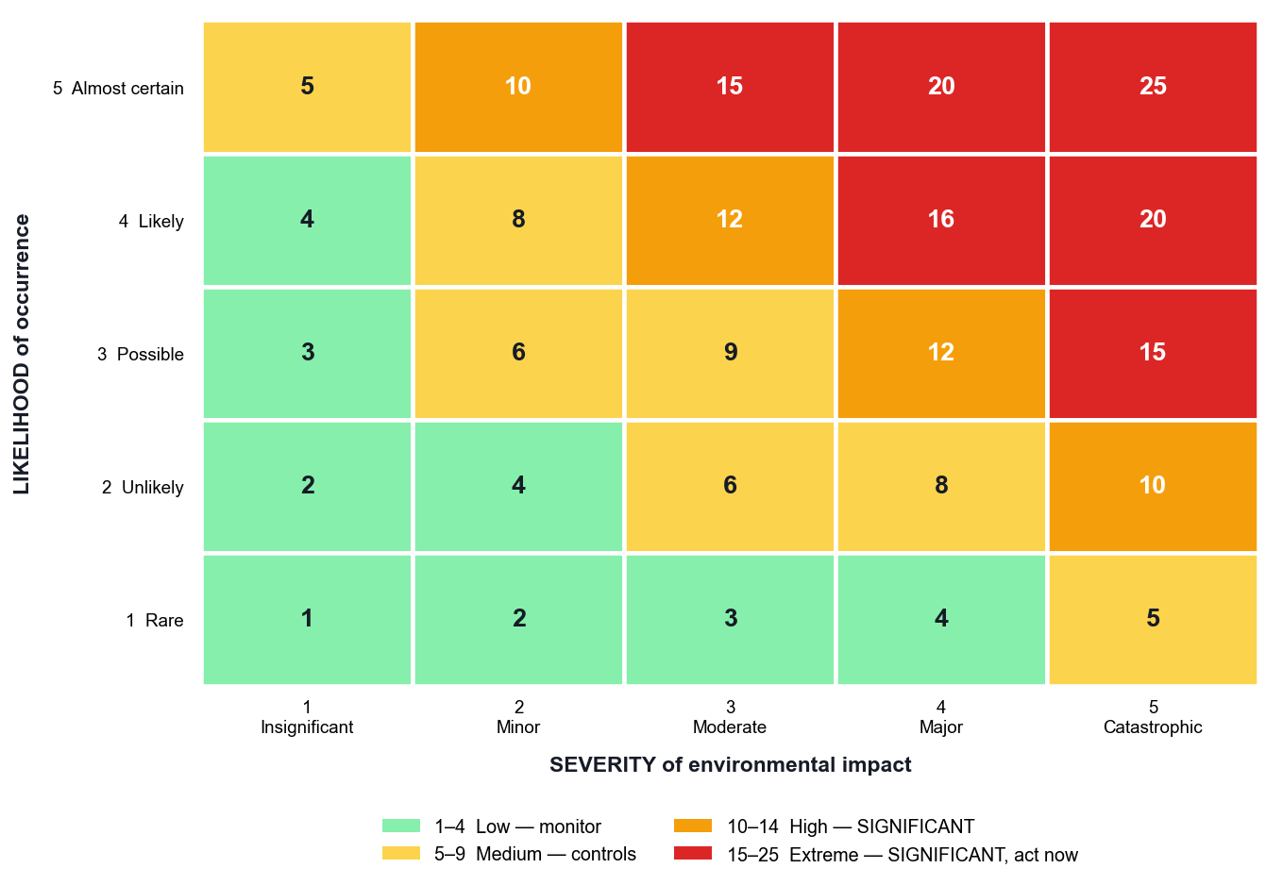
THE MOST MISUNDERSTOOD PART OF THE 2015 STANDARD
Risks and Opportunities are NOT Aspects
Aspect (6.1.2)
Your interaction with the environment. Technical and physical.
Risk / opportunity (6.1.1)
Threats and opportunities to the EMS achieving its intended outcomes. Strategic.
Aspects FEED risks
Aspects are one input to 6.1.1 — along with compliance obligations and 4.1/4.2 issues.
The common failure
Relabelling the aspect register as the 'risk register' does NOT meet clause 6.1.1.
ISO 14001-2015 Internal Auditor Training · TGS-2025054479
© 2026 Tertiary Infotech Academy Pte Ltd
44

Slide 45
WHAT YOU AUDIT · CLAUSE 6.2
Clause 6.2 — Environmental Objectives
1
6.2.1 The objective
2
6.2.2 The plan — five parts
3
The audit test
Established at relevant functions and levels, taking account of significant aspects and associated compliance obligations. Consistent with policy, measurable if practicable, monitored, communicated, updated.
WHAT will be done · WHAT RESOURCES · WHO is responsible · WHEN it completes · HOW results are evaluated, including indicators.
Trace each objective BACKWARDS to a significant aspect or obligation, and FORWARDS to 9.1 monitoring evidence and 9.3 management review.
THE POINT
'Comply with all laws' and 'zero incidents' are not improvement objectives — they are baseline expectations. Challenge them.
ISO 14001-2015 Internal Auditor Training · TGS-2025054479
© 2026 Tertiary Infotech Academy Pte Ltd
45

Slide 46
WHAT YOU AUDIT · CLAUSE 7
Clause 7 — Support
1
7.1 Resources · 7.2 Competence
2
7.3 Awareness
3
7.4 Communication
4
7.5 Documented information
Determine and provide resources. Determine necessary competence for work affecting environmental performance and the ability to fulfil compliance obligations — including contractors. RETAIN evidence of competence.
Policy, the significant aspects related to THEIR work, their contribution to EMS effectiveness, and the implications of not conforming. No documented information required — test by interview.
What, when, with whom and how. Internal communication must enable staff to CONTRIBUTE to continual improvement. External as required by compliance obligations.
Creating and updating (identification, format, review and approval); control (availability, protection, distribution, storage, change control, retention).
THE POINT
Awareness ≠ competence. Ask an operator: 'which environmental aspects relate to YOUR job, and what happens if this goes wrong?' — that is a 7.3 test, and it is where paper systems fall over.
ISO 14001-2015 Internal Auditor Training · TGS-2025054479
© 2026 Tertiary Infotech Academy Pte Ltd
46

Slide 47
WHAT YOU AUDIT · CLAUSE 8
Clause 8 — Operation
1
8.1 Operational planning and control
2
8.1 Life cycle perspective — four duties
3
8.2 Emergency preparedness and response
Establish OPERATING CRITERIA and control processes in accordance with them. Control planned changes and review unintended changes. Ensure outsourced processes are controlled or influenced.
Environmental requirements in design and development · procurement requirements · communicate requirements to external providers including contractors · consider providing information on transport, use and end-of-life.
Prepare, respond, mitigate, PERIODICALLY TEST where practicable, review and revise (especially after an incident or a test), and provide information and training.
THE POINT
A full Life Cycle Assessment is NOT required. Ask instead: 'which life cycle stages did you consider, what did you conclude you can control or influence, and why?'
ISO 14001-2015 Internal Auditor Training · TGS-2025054479
© 2026 Tertiary Infotech Academy Pte Ltd
47

Slide 48
WHAT YOU AUDIT · CLAUSE 9
Clause 9 — Performance Evaluation
1
9.1.1 Monitoring and measurement
2
9.1.2 Evaluation of compliance
3
9.2 Internal audit
4
9.3 Management review
What to monitor, methods ensuring valid results, the CRITERIA and INDICATORS for evaluating performance, and when. Equipment must be CALIBRATED OR VERIFIED.
Determine the FREQUENCY of evaluation, evaluate and act, and MAINTAIN KNOWLEDGE AND UNDERSTANDING of compliance status. Retain the results.
At planned intervals, testing conformity to ISO 14001 AND the organisation's own requirements, and effective implementation. The programme must consider environmental importance, changes, and previous results.
Seven required inputs and six required outputs — including implications for the STRATEGIC DIRECTION of the organisation.
THE POINT
9.1.2 is NOT the same as 6.1.3, and NOT the same as 9.2. 6.1.3 asks 'which obligations apply?'; 9.1.2 asks 'are we actually complying?'; 9.2 audits the system.
ISO 14001-2015 Internal Auditor Training · TGS-2025054479
© 2026 Tertiary Infotech Academy Pte Ltd
48

Slide 49
WHAT YOU AUDIT · CLAUSE 10
Clause 10 — Improvement
1
10.1 General
2
10.2 Nonconformity and corrective action
3
10.3 Continual improvement
Determine opportunities for improvement from 9.1, 9.2 and 9.3, and implement actions to achieve the intended outcomes of the EMS.
React and correct · evaluate the need to eliminate the CAUSE · determine whether similar nonconformities exist or could occur · implement · REVIEW EFFECTIVENESS · change the EMS if necessary. Retain evidence of both the NC and the results.
Continually improve the suitability, adequacy and effectiveness of the EMS TO ENHANCE ENVIRONMENTAL PERFORMANCE.
THE POINT
10.2(d) — 'review the effectiveness of any corrective action taken' — is the clause that makes 'closed without verification' a nonconformity in its own right.
ISO 14001-2015 Internal Auditor Training · TGS-2025054479
© 2026 Tertiary Infotech Academy Pte Ltd
49

Slide 50
15 MANDATORY ITEMS · 7 MAINTAIN + 8 RETAIN
Documented Information — MAINTAIN vs RETAIN
MAINTAIN (a document — how to do it)
RETAIN (a record — evidence it was done)
Clause 4–6
4.3 scope · 5.2 policy · 6.1.1 risks & opportunities · 6.1.2 aspects, criteria, significant aspects · 6.1.3 obligations
6.2.1 environmental objectives
Clause 7
—
7.2 competence · 7.4.1 communications
Clause 8
8.1 operational control · 8.2 emergency
—
Clause 9
—
9.1.1 monitoring results · 9.1.2 compliance evaluation · 9.2.2 audit programme and results · 9.3 management review
Clause 10
—
10.2 nature of NCs, actions taken, and results of corrective action
There is NO required documented procedure anywhere in ISO 14001:2015, and NO environmental manual. Never raise a nonconformity for their absence.
ISO 14001-2015 Internal Auditor Training · TGS-2025054479
© 2026 Tertiary Infotech Academy Pte Ltd
50

Slide 51
TRANSITION AWARENESS
ISO 14001:2015 was withdrawn on 15 April 2026 and replaced by ISO 14001:2026.
Certificates issued to the 2015 edition remain valid through a 36-month transition. The 10-clause high level structure is retained. This course teaches the 2015 edition because that is what most auditees are still certified to.
ISO 14001-2015 Internal Auditor Training · TGS-2025054479
© 2026 Tertiary Infotech Academy Pte Ltd
51

Slide 52
ACTIVITY 1 · 45 MIN
TOPIC 01 · HANDS-ON ACTIVITY
Activity 1 — Auditing GreenPack — Framework, Context and…
GreenPack Manufacturing has expanded capacity by 40% and added a solvent-based thermal lamination line. Energy use is up 25%, VOC emissions have risen and three odour complaints have been received — but the aspects register and policy are stale. You are the lead internal auditor: scope the engagement.
1
2
3
4
5
Read the scenario and list the IPPF components that govern your conduct
Map the symptoms to ISO 14001:2015 clauses (4.1–4.4, 5.2, 6.1.2, 8.1)
Build a context table: issues, interested parties, compliance obligations
Decide the audit scope, boundaries and the areas you will prioritise
Write the engagement note justifying scope against risk
YOU'LL PRODUCE A completed Audit Engagement Scoping Note for GreenPack — clause map, context table, prioritised scope and the IPPF basis for your independence.
Materials: Activity 1 brief · ISO 14001:2015 clause map · Context & scope template · Full step-by-step guide: Learner Guide, Activity 1
ISO 14001-2015 Internal Auditor Training · TGS-2025054479
© 2026 Tertiary Infotech Academy Pte Ltd
52

Slide 53
TOPIC 01 · SELF-CHECK
Activity 1 — Check Your Work
YOU ARE DONE WHEN
Your scoping note names at least 8 relevant clauses each tied to a specific scenario fact, ranks the lamination line as the top priority with a stated reason, and contains an explicit auditor-independence statement.
IF YOU ARE STUCK — WHAT USUALLY GOES WRONG
• You listed clauses but did not tie each one to a fact from the scenario — the clause map must be evidence-led, not a contents page.
• You allocated equal audit time to all three departments. Audit effort follows environmental risk and change; say so and defend it.
• You treated the odour complaints as the finding. They are a SYMPTOM — the stale aspects register is the systemic issue.
• You forgot the independence statement. The IPPF requires objectivity to be considered and recorded before the engagement starts.
• You wrote 'the policy is old' without naming clause 5.2 and what it requires.
ISO 14001-2015 Internal Auditor Training · TGS-2025054479
© 2026 Tertiary Infotech Academy Pte Ltd
53

Slide 54
Tea Break
15 minutes

Slide 55
TOPIC 02
Auditing ISO 14001:2015
ISO 19011:2018 principles · audit programme vs audit · the six-stage lifecycle · checklists, evidence, interviewing · stakeholders
02
ISO 14001-2015 Internal Auditor Training · TGS-2025054479
© 2026 Tertiary Infotech Academy Pte Ltd
55

Slide 56
GET THIS RIGHT FIRST
ISO 19011 tells you HOW to audit. ISO 14001 clause 9.2 says you MUST.
ISO 19011:2018 is written entirely in 'should' — it is guidance, not requirements. You never raise a nonconformity 'against ISO 19011'.
ISO 14001-2015 Internal Auditor Training · TGS-2025054479
© 2026 Tertiary Infotech Academy Pte Ltd
56

Slide 57
THE PROFESSIONAL FOUNDATION
The Seven Audit Principles — ISO 19011:2018 Clause 4
1
Integrity
The foundation of professionalism — perform work honestly, diligently and responsibly.
2
Fair presentation
The obligation to report truthfully and accurately — including unresolved disagreements.
3
Due professional care
Diligence and judgement appropriate to the importance of the task and the confidence placed in the auditor.
4
Confidentiality
Security of information — auditors must not use information for personal gain or to the detriment of the auditee.
5
Independence
The basis for impartiality and objectivity of the audit conclusions — auditors do not audit their own work.
6
Evidence-based approach
The rational method for reaching reliable and REPRODUCIBLE conclusions in a systematic process.
7
Risk-based approach
An audit approach that considers risks and opportunities — new in the 2018 edition.
ISO 14001-2015 Internal Auditor Training · TGS-2025054479
© 2026 Tertiary Infotech Academy Pte Ltd
57

Slide 58
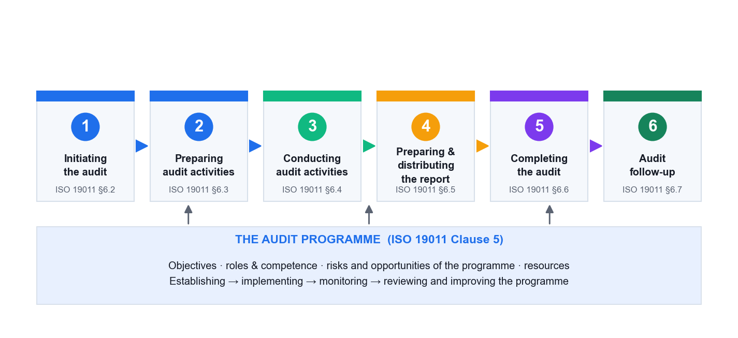
THE DISTINCTION MOST COURSES SKIP
Audit Programme vs Individual Audit
Clause 5 manages the PROGRAMME — the whole schedule of audits for the year. Clause 6 conducts ONE audit. ISO 14001 clause 9.2.2 requires the programme to consider environmental importance, changes, and previous audit results.
ISO 14001-2015 Internal Auditor Training · TGS-2025054479
© 2026 Tertiary Infotech Academy Pte Ltd
58

Slide 59
TWO DIFFERENT CONVERSATIONS
Programme Findings vs Audit Findings
PROGRAMME-LEVEL (ISO 14001 cl. 9.2.2)
AUDIT-LEVEL (this one audit)
– The audit procedure has not been updated after major change
– Equal audit time regardless of environmental risk
– Previous nonconformities closed without verification
– Auditors not competent or not impartial
– Results not reported to relevant management
– The programme itself is not monitored or improved
– A checklist that does not cover the audit criteria
– Evidence not verified before a finding is raised
– A nonconformity statement missing its evidence
– No opening or closing meeting held
– The report omits the sampling limitation
– Findings not agreed with the auditee before reporting
Fixing a programme finding improves every future audit. Fixing an audit finding improves one. Know which one you are looking at.
ISO 14001-2015 Internal Auditor Training · TGS-2025054479
© 2026 Tertiary Infotech Academy Pte Ltd
59

Slide 60
ISO 19011:2018 §6.2 – §6.7
The Six-Stage Audit Lifecycle
1
2
3
4
5
6
Initiating
Preparing
Conducting
Reporting
Completing
Follow-up
Contact the auditee · confirm feasibility and authority
Document review · audit plan · work assignment · checklist
Opening meeting · collect and VERIFY · findings · closing
Prepare and distribute the audit report
Distribute · retain records · close the audit
Verify the corrective actions were effective
THE POINT
Every commercial provider researched teaches this same sequence. Stage 6 is the one organisations most often skip — and skipping it is what turns 'closed' nonconformities into repeat findings.
ISO 14001-2015 Internal Auditor Training · TGS-2025054479
© 2026 Tertiary Infotech Academy Pte Ltd
60

Slide 61
ISO 19011 CLAUSE 5 · THE YEAR, NOT THE DAY
Clause 5 — Managing the Audit Programme
1
Establish programme objectives
Driven by management priorities, the significant aspects, compliance obligations and previous results.
2
Determine programme risks and opportunities
Resourcing, scheduling, auditor competence, access, and ineffective follow-up.
3
Establish the programme
Frequency, methods, responsibilities, planning requirements and reporting — ISO 14001 cl. 9.2.2.
4
Implement it
Schedule audits, select and assign competent auditors, manage records.
5
Monitor it
Are audits happening on schedule? Are findings being closed? Are auditors performing?
6
Review and improve it
Feed the programme's own performance back into next year's programme.
ISO 14001 cl. 9.2.2 requires the programme to take into account the environmental importance of the processes concerned, changes affecting the organisation, and the results of previous audits. All three are directly auditable.
ISO 14001-2015 Internal Auditor Training · TGS-2025054479
© 2026 Tertiary Infotech Academy Pte Ltd
61

Slide 62
ISO 19011 A.6
Sampling — Why Every Audit Report Carries a Caveat
1
You cannot audit everything
2
Judgement-based sampling
3
Statistical sampling
4
State the basis and its limit
An audit examines a SAMPLE of evidence within a finite time. That is not a weakness — it is the definition of auditing.
Chosen by risk: the newest process, the biggest aspect, the area with previous findings, the shift nobody watches. Most internal audits use this.
Random selection allowing a confidence level to be stated. Used where populations are large and homogeneous, e.g. thousands of waste tickets.
Record what you sampled and why — and put the sampling statement in the report. Absence of a finding is NOT proof of conformity.
THE POINT
If you cannot explain WHY you looked at those three drums and not the other forty, your finding is vulnerable at the closing meeting.
ISO 14001-2015 Internal Auditor Training · TGS-2025054479
© 2026 Tertiary Infotech Academy Pte Ltd
62

Slide 63
TRACEABILITY IN PRACTICE
Following an Audit Trail
1
2
3
4
5
Start at a claim
Ask for the record
Verify the counterparty
Reconcile the quantities
Close or escalate
'All hazardous waste goes to a licensed collector'
Show me last month's consignment notes
Is the collector licensed for THAT waste stream?
Do the notes match the waste actually generated?
Consistent → conformity. Gap → collect more evidence
THE POINT
An audit trail is a chain: claim → record → verification → reconciliation. Each link is a chance to find the gap, and the whole chain is what makes a finding defensible six months later.
ISO 14001-2015 Internal Auditor Training · TGS-2025054479
© 2026 Tertiary Infotech Academy Pte Ltd
63

Slide 64
ISO 19011 §6.3
Stage 2 — Preparing: What Actually Happens
1
Review documented information
The EMS documentation, previous audit reports, the aspects register, the legal register, licences and monitoring data. Determine adequacy BEFORE you go on site.
2
Prepare the audit plan
Objectives, criteria, scope, locations, dates and times, methods, roles, and the opening and closing meeting times. Agreed with the auditee.
3
Assign work to the audit team
Who audits which process, which clause, which shift, which site.
4
Prepare work documents
The checklist, sampling plans and forms for recording evidence. These are working papers — they are retained.
5
Decide the sampling approach
How many, which ones, over what period — and be ready to justify it. Sampling is why every audit report carries the uncertainty caveat.
An audit that is under-prepared cannot be rescued on site. Most weak audits fail here.
ISO 14001-2015 Internal Auditor Training · TGS-2025054479
© 2026 Tertiary Infotech Academy Pte Ltd
64

Slide 65
WORK DOCUMENTS · §6.3.4
The Audit Checklist — What Makes One Good
1
Organisation-specific
2
Risk-weighted
3
Three columns minimum
4
A guide, not a script
Built from THIS auditee's processes, aspects and obligations. A generic clause-by-clause tick-list is the single most common weakness.
More lines against the significant aspects, the recent changes and the previous findings; fewer against low-risk administrative processes.
The CLAUSE or requirement · the QUESTION you will ask · the EVIDENCE you expect to see. The third column is what most checklists omit.
Follow the audit trail where it leads. A checklist that stops you investigating something you have just discovered is being used wrongly.
THE POINT
Bureau Veritas and TÜV SÜD both single out checklist customisation as a core skill. Build it from the aspects register, not from the standard's contents page.
ISO 14001-2015 Internal Auditor Training · TGS-2025054479
© 2026 Tertiary Infotech Academy Pte Ltd
65

Slide 66
COPY THIS STRUCTURE
A Risk-Based Checklist Line — the Shape
Clause / requirement
The question I will ask
Evidence I expect to see
6.1.2 aspects · change
How were aspects re-assessed after the new line was commissioned?
Dated register entry for the new process; the change record
6.1.3 obligations
Which discharge limits apply to you, and how did you determine that?
Licence/Written Approval; legal register with applicability noted
9.1.1 monitoring
How do you know the monitoring result is valid?
Calibration certificate in date; accredited lab report
9.1.2 compliance
How often do you evaluate compliance, and what did the last one find?
Compliance evaluation record and the actions arising
10.2 corrective action
How did you verify last year's corrective action worked?
Effectiveness review record — NOT just a 'closed' status
ISO 14001-2015 Internal Auditor Training · TGS-2025054479
© 2026 Tertiary Infotech Academy Pte Ltd
66

Slide 67
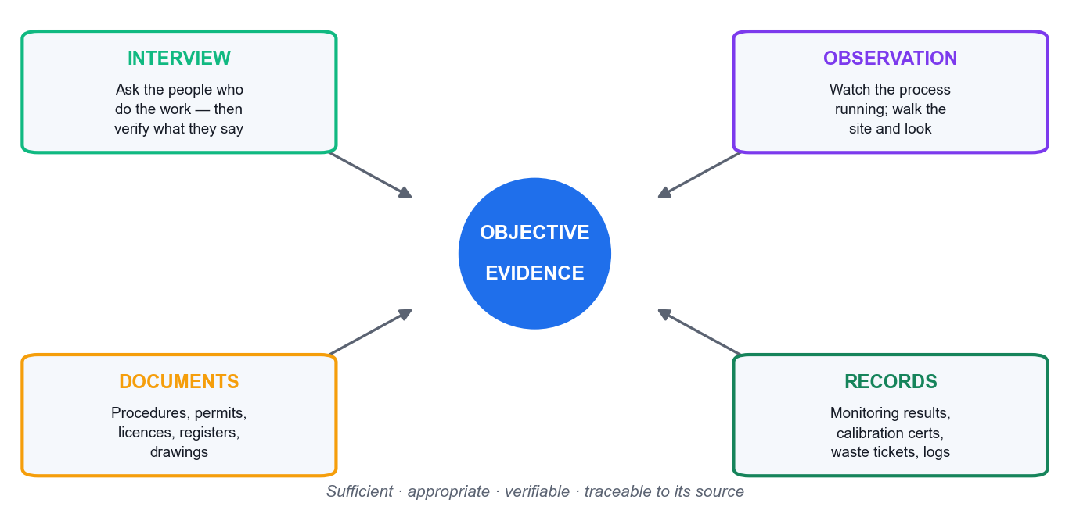
OBJECTIVE EVIDENCE · ISO 19011
Audit Evidence — the Four Sources
Interview
What people say. The weakest form on its own — always verify it.
Observation
What you see happening. Strong, but a snapshot in time.
Documents
Procedures, permits, licences, drawings — what is SUPPOSED to happen.
Records
Monitoring results, certificates, logs — evidence it DID happen.
The test
Sufficient, appropriate, verifiable and TRACEABLE to its source.
An interview answer alone rarely closes a line of enquiry. Either you saw it, or there is a record of it, or you have not verified it.
ISO 14001-2015 Internal Auditor Training · TGS-2025054479
© 2026 Tertiary Infotech Academy Pte Ltd
67

Slide 68
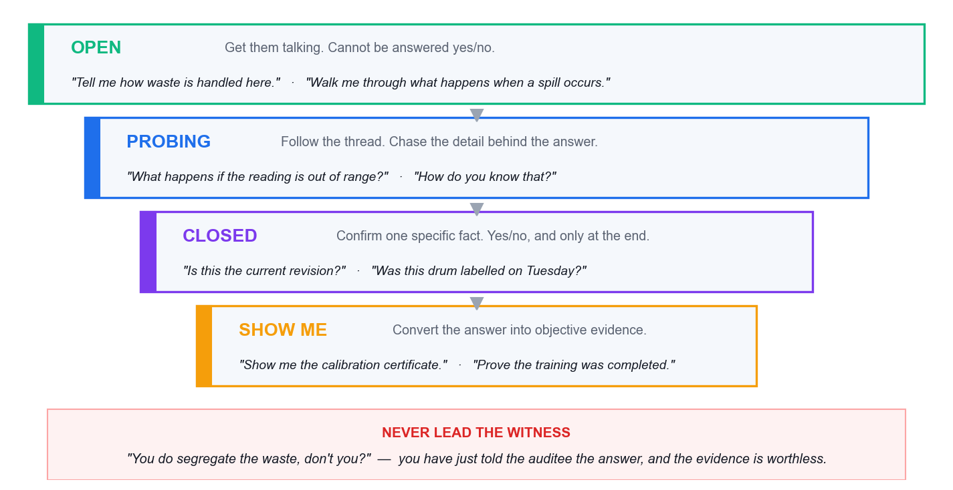
WHERE MOST NEW AUDITORS FAIL
Questioning Technique — the Funnel
Roughly 70% open and probing, 30% closed. A funnel that STARTS closed ('do you have a procedure?') gets a yes and teaches you nothing.
ISO 14001-2015 Internal Auditor Training · TGS-2025054479
© 2026 Tertiary Infotech Academy Pte Ltd
68

Slide 69
THE SYSTEMATIC QUESTION SET
5W1H — Guaranteeing You Miss No Dimension
The question
Applied to an EMS process
What
What is done? What is the requirement?
What environmental aspects arise from this activity?
Why
Why is it done this way? Why this control?
Why was this aspect rated not significant?
Who
Who does it? Who is competent or authorised?
Who is authorised to sign the waste consignment note?
Where
Where is it done? Where is it recorded?
Where is the spill kit, and where is the nearest drain?
When
When is it done? How often? When last?
When was the emergency response last tested?
How
How is it controlled, measured, verified?
How do you verify the disposal contractor is licensed?
Two extensions worth teaching: 'how much / how many' quantifies, and 'what if' tests the abnormal and emergency conditions clause 6.1.2 and 8.2 require.
ISO 14001-2015 Internal Auditor Training · TGS-2025054479
© 2026 Tertiary Infotech Academy Pte Ltd
69

Slide 70
ISO 19011 A.17 · CONDUCTING INTERVIEWS
Interviewing — What Works and What Destroys Evidence
✗ NEVER DO THIS
✓ DO THIS INSTEAD
– Leading: 'you do calibrate that, don't you?'
– Compound: three questions in one breath
– Interrogating: rapid-fire closed questions
– Talking more than the auditee
– Consulting: 'what you should do is…'
– Naming individuals in a finding
– Interviewing only managers
– Accepting 'we always do it that way'
– Open first: 'walk me through what happens…'
– One question, then WAIT — the pause does the work
– Explain why you are there and why you take notes
– Target: the auditor talks less than 30% of the time
– Note the gap; let the auditee design the fix
– Address the system, never the person
– Managers describe the procedure; operators reveal the practice
– 'Show me' — convert every claim into evidence
Interviewing is the largest published gap in the commercial market — only two of seven major providers teach questioning technique at all. It is also where new internal auditors most often fail.
ISO 14001-2015 Internal Auditor Training · TGS-2025054479
© 2026 Tertiary Infotech Academy Pte Ltd
70

Slide 71
A NOTE-TAKING DISCIPLINE — NOT AN ISO TERM
PLOD — Capturing Traceable Evidence as You Find It
P — Person
The ROLE interviewed, never the individual's name: 'the Warehouse Supervisor'.
L — Location
Building, area, line, tank: 'Chemical Store B, external yard'.
1
2
O — Object
The physical thing with its identifier: 'drums WD-104/105/106'.
D — Document
Document identity AND revision or date: 'EMS-P-08 Rev 4, cl. 5.3'.
3
4
ISO 14001-2015 Internal Auditor Training · TGS-2025054479
© 2026 Tertiary Infotech Academy Pte Ltd
71

Slide 72
THE TEST OF A GOOD NOTE
If your note has none of P, L, O or D, you have an impression — not evidence.
A finding must be re-findable. Another auditor, six months later, should be able to go to the same place, ask for the same document and reach the same conclusion.
ISO 14001-2015 Internal Auditor Training · TGS-2025054479
© 2026 Tertiary Infotech Academy Pte Ltd
72

Slide 73
ISO 19011 §6.4.2
The Opening Meeting — the Standard Agenda
1
Introductions and roles
Audit team, auditee representatives, guides and observers.
2
Confirm the audit plan
Objectives, scope, criteria, timetable and the closing meeting time.
3
Confirm communication channels
Who the audit team reports to during the audit; how issues are escalated.
4
Explain the method and the SAMPLING basis
And that sampling means the audit carries an element of uncertainty.
5
Explain how findings will be graded and reported
Major, minor, OFI — and what each means here.
6
Confirm safety, escort and facility arrangements
PPE, restricted areas, emergency procedures.
7
Invite questions
Confirm the auditee understands and agrees before fieldwork begins.
ISO 14001-2015 Internal Auditor Training · TGS-2025054479
© 2026 Tertiary Infotech Academy Pte Ltd
73

Slide 74
ISO 19011 §6.4.10
The Closing Meeting — the Standard Agenda
1
Thank the auditee
And restate the audit objective and scope.
2
Restate the sampling caveat
Findings are based on sampled evidence — absence of a finding is not proof of conformity.
3
Present the findings
Each with its evidence and its grade, so they are understood and acknowledged.
4
Present the audit conclusion
On conformity and on effective implementation and maintenance.
5
Agree the corrective action process
Owners, timeframes and how effectiveness will be verified.
6
Record any diverging opinions
Unresolved disagreements are REPORTED, not suppressed — that is fair presentation.
7
Confirm the report and follow-up
Distribution, timing and the follow-up arrangement.
ISO 14001-2015 Internal Auditor Training · TGS-2025054479
© 2026 Tertiary Infotech Academy Pte Ltd
74

Slide 75
K3 · A2 · WHO YOU DEAL WITH
Engaging the Stakeholders — They Are Not All the Same
Operations staff
Your primary evidence source. Interview at their normal workplace, put them at ease, never blame.
Process owners / managers
Describe the intended procedure and own the corrective actions. Contrast what they say with what operators do.
1
2
Top management
Opening and closing meetings; leadership (5.1), resources (7.1) and the programme-level findings.
Client representatives
NOT the auditee. Gatekeepers for site access — get permission in advance and protect confidentiality.
3
4
Regulators (NEA, PUB)
Engaged INDIRECTLY — through licences, submitted returns and correspondence. An internal auditor does not interview them.
Contractors on site
Work 'under the control of' the organisation — clause 7.2 competence and 8.1 outsourced control apply to them.
5
6
ISO 14001-2015 Internal Auditor Training · TGS-2025054479
© 2026 Tertiary Infotech Academy Pte Ltd
75

Slide 76
ACTIVITY 2 · 60 MIN
TOPIC 02 · HANDS-ON ACTIVITY
Activity 2 — AquaPure — Planning the Engagement and the…
AquaPure's workload has tripled on a new government contract, its audit procedure is five years old, and two 'closed' nonconformities have no verification evidence. Plan the engagement stage by stage, build the checklist, and decide how you will handle each stakeholder group.
1
2
3
4
5
Walk the ISO 19011 §6.2–6.7 lifecycle and list actions for AquaPure at each stage
Draft the audit plan: objective, criteria, scope, sampling and timetable
Write 8 checklist lines with the clause, the question and the evidence sought
Build the stakeholder engagement matrix for the four groups
Rehearse the opening meeting and one interview using the questioning funnel
YOU'LL PRODUCE An Audit Plan + an 8-line risk-based Audit Checklist + a Stakeholder Engagement Matrix for the AquaPure wastewater audit, plus a rehearsed opening-meeting script.
Materials: Activity 2 brief · ISO 19011:2018 lifecycle map · Checklist and plan templates · Full step-by-step guide: Learner Guide, Activity 2
ISO 14001-2015 Internal Auditor Training · TGS-2025054479
© 2026 Tertiary Infotech Academy Pte Ltd
76

Slide 77
TOPIC 02 · SELF-CHECK
Activity 2 — Check Your Work
YOU ARE DONE WHEN
Your checklist has at least 8 lines, every line names a clause AND the specific evidence you will ask to see, at least 4 lines target mobile operations / calibration / training / the previous NCs, and your matrix treats client representatives differently from the auditee.
IF YOU ARE STUCK — WHAT USUALLY GOES WRONG
• Your checklist is a generic clause-by-clause tick-list. Rebuild it from AquaPure's own risks: mobile units, calibration, training, discharge monitoring.
• You missed the third checklist column. Every line needs the EVIDENCE you expect to see, not just the question.
• You classified the 5-year-old procedure as an audit finding. It is a PROGRAMME finding against ISO 14001 cl. 9.2.2.
• You accepted 'closed' on the two previous NCs. Clause 10.2(d) requires a review of EFFECTIVENESS — no evidence means no closure.
• You planned to interview the regulator. Internal auditors engage NEA indirectly, through licences, returns and correspondence.
• You forgot client-site access. If you cannot reach the mobile units, the audit is not feasible as scoped — raise it at initiation, not in the report.
ISO 14001-2015 Internal Auditor Training · TGS-2025054479
© 2026 Tertiary Infotech Academy Pte Ltd
77

Slide 78
Lunch Break
45 minutes

Slide 79
TOPIC 03
Risk Assessment
Aspect/impact significance · risk matrices and FMEA · nonconformity grading · root cause analysis · CARs · the audit report
03
ISO 14001-2015 Internal Auditor Training · TGS-2025054479
© 2026 Tertiary Infotech Academy Pte Ltd
79

Slide 80
K4 · RISK ASSESSMENT TECHNIQUES
Evaluating Significance — the 5×5 Matrix
Score = Severity × Likelihood
The most common method, and defensible if the criteria are documented.
Threshold ≥ 10 = significant
High and Extreme bands. The threshold itself is what an auditor challenges.
ISO prescribes NO method
6.1.2 requires only that significance is determined BY ESTABLISHED CRITERIA.
The real audit question
Not 'is your method right?' but 'is it documented, criteria-based and consistently applied?'
ISO 14001-2015 Internal Auditor Training · TGS-2025054479
© 2026 Tertiary Infotech Academy Pte Ltd
80

Slide 81
WHY SCORING ALONE IS NOT ENOUGH
The Override Rules — What Makes an Aspect Automatically Significant
1
A legal limit applies
2
A regulator has acted
3
A substantiated complaint
4
Controlled substances or waste
The aspect is subject to a regulatory limit, licence or permit condition — regardless of its arithmetic score.
A notice, warning, fine or prosecution in the last three years.
An interested party has complained and the complaint was upheld.
The aspect involves a listed hazardous substance or toxic industrial waste.
THE POINT
Without override rules, a licensed discharge can score 'medium' and drop off the significant list — the classic finding where the aspects register has become disconnected from the legal register.
ISO 14001-2015 Internal Auditor Training · TGS-2025054479
© 2026 Tertiary Infotech Academy Pte Ltd
81

Slide 82
K4 · THE TOOLKIT
Three Significance Methods — Pick One and Document It
Method
How it scores
Best for
Severity × Likelihood
5×5, score 1–25; significant at ≥ 10
SMEs and first registers — simple and defensible
Multi-criteria weighted
Severity × Frequency × Legal × Stakeholder, or a weighted sum
Larger organisations — builds in obligations and interested parties
FMEA (S × O × D)
RPN 1–1000; act at ≥ 100; any S ≥ 9 acts regardless
Abnormal and emergency aspects where DETECTION matters
FMEA adds the dimension the others miss: can we DETECT the failure before it becomes an impact? The cheapest risk reduction is almost always better detection — which is exactly what clause 9.1 monitoring is for.
ISO 14001-2015 Internal Auditor Training · TGS-2025054479
© 2026 Tertiary Infotech Academy Pte Ltd
82

Slide 83
TAKE THESE ON SITE
Auditing the Significance Method — Questions That Find Weakness
Show me the documented criteria.
If the criteria live only in a spreadsheet formula or someone's head, that is a 6.1.2 finding.
Who approved them, and when?
No approval, no date, no version control.
1
2
Would two assessors score this the same?
Test it live — re-score one aspect with the process owner.
This has a legal limit but scored 6. Explain.
Tests whether override rules exist.
3
4
Show me how each significant aspect reaches a control.
6.1.2 → 8.1 → 9.1. A register nothing references is shelf-ware.
Why did significant aspects drop from 30 to 6?
Tests whether the threshold was quietly moved to reduce work.
5
6
ISO 14001-2015 Internal Auditor Training · TGS-2025054479
© 2026 Tertiary Infotech Academy Pte Ltd
83

Slide 84
WHEN SEVERITY × LIKELIHOOD IS TOO COARSE
FMEA for Environmental Risk — S × O × D
Dimension
What it rates
The audit insight
Severity (S)
How bad the environmental consequence is, 1–10
You cannot usually reduce it — a solvent stays toxic
Occurrence (O)
How likely the failure mode is, 1–10
Reduced by maintenance, design and competence
Detection (D)
Ability to detect BEFORE impact — INVERTED scale, 1 = certain
The cheapest and fastest RPN reduction available
RPN = S × O × D
1–1000; act at ≥ 100; any S ≥ 9 acts regardless of RPN
Links directly to clause 9.1 monitoring and measurement
Worked example: cracked bund, S=9 O=4 D=7 → RPN 252. Add a leak-detection sensor and D falls to 2 → RPN 72. Same hazard, same likelihood, but now you find out before it reaches the soil.
ISO 14001-2015 Internal Auditor Training · TGS-2025054479
© 2026 Tertiary Infotech Academy Pte Ltd
84

Slide 85
CLAUSE 6.2.2 · A RELIABLE CHECKLIST
Environmental Objectives — the 6.2.2 Five-Part Test
Requirement
The audit question
Weak answer
What will be done
What are the actual actions and programme?
'Improve energy efficiency' — that is the objective, not the plan
What resources
Is the budget approved and released?
No capex, no headcount — a paper objective
Who is responsible
Which NAMED role owns it?
'The EHS department'
When completed
Target date and milestones?
'Ongoing'
How evaluated
Which indicator, measured how, how often, by whom?
No indicator, or an indicator with no calibrated measurement
Trace every objective BACKWARDS to a significant aspect, obligation or risk, and FORWARDS to 9.1 monitoring and 9.3 management review. An orphan objective means the 6.1 → 6.2 link is broken.
ISO 14001-2015 Internal Auditor Training · TGS-2025054479
© 2026 Tertiary Infotech Academy Pte Ltd
85

Slide 86
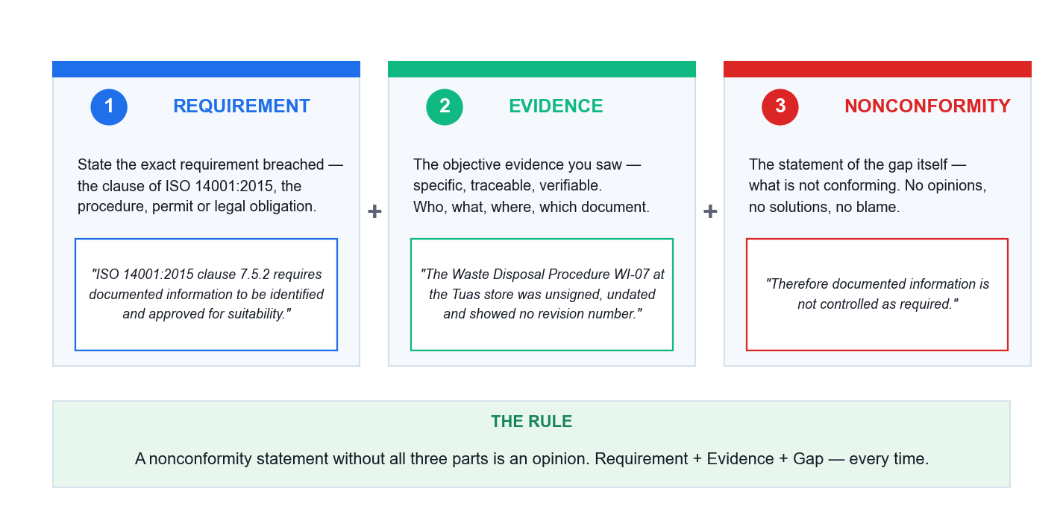
THE MOST IMPORTANT SKILL IN THIS COURSE
Writing a Nonconformity — the Three-Part Structure
Requirement + Evidence + the statement of the gap. Miss any one and you have written an opinion, which the auditee is entitled to reject.
ISO 14001-2015 Internal Auditor Training · TGS-2025054479
© 2026 Tertiary Infotech Academy Pte Ltd
86

Slide 87
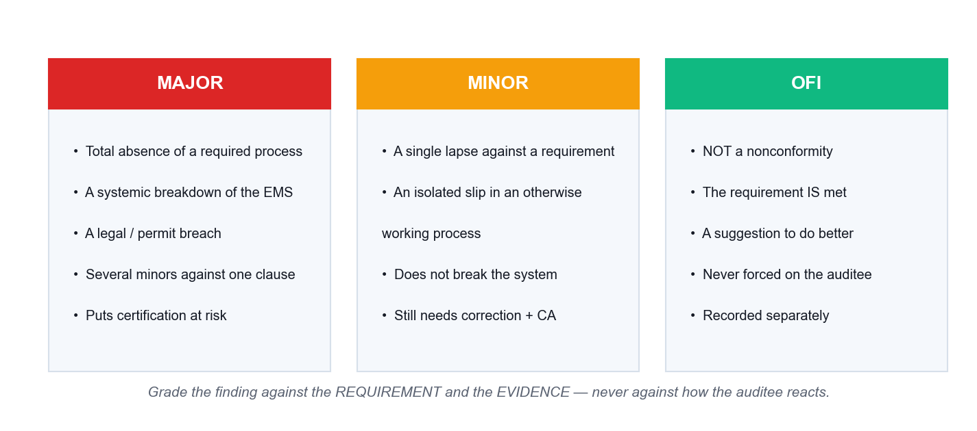
AND WHERE THE CRITERIA COME FROM
Grading the Finding — Major, Minor or OFI
ISO 19011 says only that findings 'can be graded'. The major/minor criteria come from ISO/IEC 17021-1 and from your own organisation's audit procedure — so define them in the procedure and apply them consistently.
ISO 14001-2015 Internal Auditor Training · TGS-2025054479
© 2026 Tertiary Infotech Academy Pte Ltd
87

Slide 88
REWRITE EVERY WEAK ONE
Nonconformity Statements — Bad and Good
✗ WEAK — will be rejected
✓ STRONG — evidence-based
– 'Housekeeping in the chemical store is poor.'
– → opinion, no requirement, no evidence
– 'The operator did not follow the procedure.'
– → blames a person, names no requirement
– 'You should install a new bund.'
– → that is consulting, not a finding
– 'Training records were not very good.'
– → vague, not traceable, not re-findable
– 'ISO 14001:2015 cl. 8.1 requires operational controls...
– ...On 14 Aug 2026, three 200 L drums (WD-104/105/106) in Chemical Store B bore no contents or hazard labels...
– ...therefore operational control for hazardous waste storage is not implemented as required.'
– Requirement + Evidence + Gap
– Traceable: another auditor can re-find it
– Addresses the SYSTEM, not the person
Write findings so that a reader who was not there understands exactly what was seen, where, and which requirement it breaches.
ISO 14001-2015 Internal Auditor Training · TGS-2025054479
© 2026 Tertiary Infotech Academy Pte Ltd
88

Slide 89
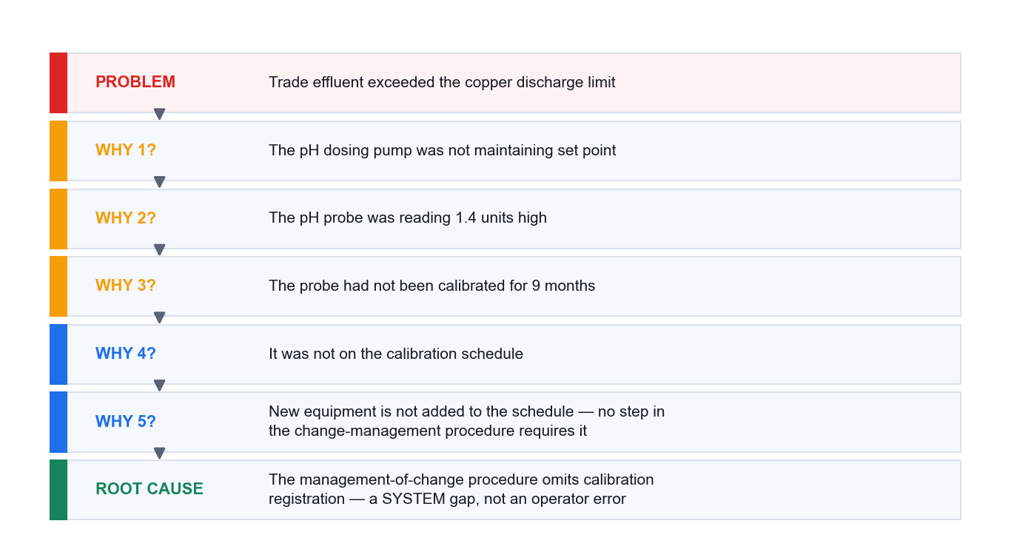
STOP AT A PROCESS, NOT AT A PERSON
Root Cause Analysis — 5 Whys Worked Through
If your 5 Whys ends at 'the operator forgot', you have found a symptom. Push until you reach a step that is missing from a process — that is what corrective action can actually fix.
ISO 14001-2015 Internal Auditor Training · TGS-2025054479
© 2026 Tertiary Infotech Academy Pte Ltd
89

Slide 90
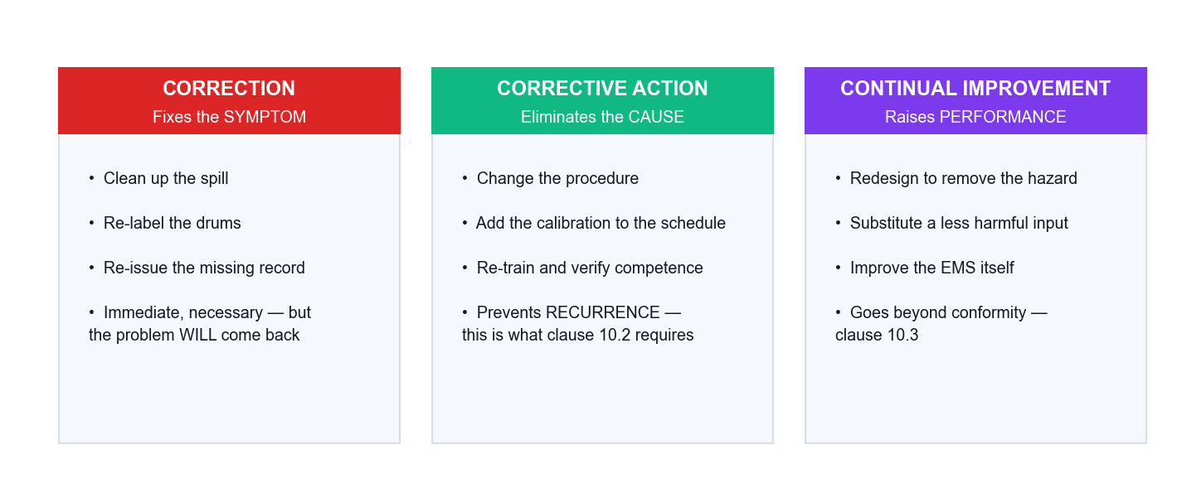
CLAUSE 10.2 VS 10.3
Correction vs Corrective Action vs Improvement
Clause 10.2 requires BOTH: react and correct, AND evaluate the need to eliminate the cause so it does not recur. A CAR that only lists corrections is an incomplete CAR.
ISO 14001-2015 Internal Auditor Training · TGS-2025054479
© 2026 Tertiary Infotech Academy Pte Ltd
90

Slide 91
THE CAR · A3
Writing an Effective Corrective Action Request
1
The nonconformity statement
Requirement + evidence + gap, with the clause cited.
2
The grade and its justification
Major, minor or OFI — and WHY, against your defined criteria.
3
Root cause
Reached by 5 Whys or fishbone; must be a process or system cause.
4
Correction
What fixes the immediate problem and contains the consequences — including mitigating the environmental impact (10.2a).
5
Corrective action
What eliminates the cause so it does not recur OR OCCUR ELSEWHERE — and whether similar NCs exist in other areas (10.2b).
6
Owner and due date
A named role and a real date.
7
Effectiveness verification
How and when you will confirm it worked — required by 10.2(d) and retained under 10.2.
'Re-trained the operator' is the most over-used and least effective corrective action in industry. Ask: if that person leaves tomorrow, does the problem return?
ISO 14001-2015 Internal Auditor Training · TGS-2025054479
© 2026 Tertiary Infotech Academy Pte Ltd
91

Slide 92
ISO 19011 §6.5 · A3
The Audit Report — What Must Be In It
1
Audit objectives, scope and criteria
Including what was EXCLUDED.
2
Audit team, auditees and dates
Who audited, who was audited, when.
3
The audit findings
Each with its evidence, its clause and its grade.
4
The audit conclusion
On conformity AND on effective implementation and maintenance — clause 9.2.1 requires both.
5
The sampling statement
That the audit was a sampling exercise and therefore carries uncertainty — the single most commonly OMITTED element.
6
Opportunities for improvement
Kept clearly SEPARATE from nonconformities.
7
Agreed actions, owners and dates
And the follow-up arrangement.
8
Distribution list
Reported to relevant management — ISO 14001 cl. 9.2.2.
Report item (k) — the sampling caveat — protects both the auditor and the organisation. Absence of a finding is never proof of conformity.
ISO 14001-2015 Internal Auditor Training · TGS-2025054479
© 2026 Tertiary Infotech Academy Pte Ltd
92

Slide 93
ISO 19011 §6.7 · ISO 14001 CL. 10.2
Stage 6 — Audit Follow-Up: the Stage Everyone Skips
1
2
3
4
5
Receive the action plan
Review its adequacy
Verify implementation
Verify EFFECTIVENESS
Close and record
Root cause, correction, corrective action, dates
Does the action actually address the ROOT cause?
Was it done? Evidence, not assertion
Has the problem stopped recurring? — cl. 10.2(d)
Retain evidence of the NC, the action AND the result
THE POINT
'Closed' is a status, not a conclusion. Clause 10.2(d) requires a review of the EFFECTIVENESS of corrective action, and 10.2 requires the result to be retained. Closure without that evidence is itself a nonconformity.
ISO 14001-2015 Internal Auditor Training · TGS-2025054479
© 2026 Tertiary Infotech Academy Pte Ltd
93

Slide 94
THE TEST: WOULD THIS SURVIVE THE PERSON LEAVING?
Corrective Actions — Weak and Strong
✗ WEAK — the problem will return
✓ STRONG — the cause is removed
– 'Operator re-trained.'
– → if that person leaves, the gap returns
– 'Reminded staff at the toolbox talk.'
– → no change to any process
– 'Increased management awareness.'
– → unmeasurable, unverifiable
– 'Will monitor more closely.'
– → no owner, no frequency, no criterion
– 'Amended MOC procedure PR-12 to require an
– environmental re-assessment before any volume
– or process change — effective 1 Sep 2026.'
– 'Added bund integrity testing to the PM schedule
– at 12-month frequency, owner: Facilities Manager.'
– 'Installed continuous pH monitoring with an
– interlocked shut-off on the discharge line.'
– Process changed · owner named · date set · verifiable
Re-training is the most over-used corrective action in industry. It is sometimes right — but only when the root cause genuinely IS a competence gap, and then clause 7.2 requires you to evaluate the effectiveness of the training.
ISO 14001-2015 Internal Auditor Training · TGS-2025054479
© 2026 Tertiary Infotech Academy Pte Ltd
94

Slide 95
THE PITFALLS
Common Auditor Mistakes — Recognise Them In Yourself
Auditing the person, not the process
'Why didn't YOU fill this in?' kills cooperation and finds nothing.
Raising an NC against a 'should'
Only 'shall' statements are requirements.
1
2
Demanding documents that are not required
No procedure, no manual, no preventive action procedure is required.
Consulting mid-audit
You become the author of what you must audit next year.
3
4
Accepting an assertion as evidence
'We always do that.' Show me.
Stopping the 5 Whys at human error
Human error is a symptom. Find the process gap.
5
6
ISO 14001-2015 Internal Auditor Training · TGS-2025054479
© 2026 Tertiary Infotech Academy Pte Ltd
95

Slide 96
ACTIVITY 3 · 75 MIN
TOPIC 03 · HANDS-ON ACTIVITY
Activity 3 — EcoTech Electronics — Risk Assessment, CARs…
EcoTech failed an NEA inspection for exceeding its copper discharge limit, three hazardous waste containers are unlabelled, the spill bund is cracked, and the EHS Manager post has been vacant for three months. Assess the risks, write the CARs, and draft the report.
1
2
3
4
5
Build the aspect/impact register for the five problem areas
Score each risk on the 5×5 matrix and set the significance threshold
Run 5 Whys on the copper exceedance to reach the true root cause
Write 3 CARs — requirement + evidence + nonconformity, graded
Draft the audit report sections and the conclusion on effectiveness
YOU'LL PRODUCE A prioritised environmental risk assessment, three fully-written Corrective Action Requests with root cause analysis, and the skeleton of the audit report to EcoTech's management.
Materials: Activity 3 brief · 5×5 risk matrix · CAR form · Audit report template · Full step-by-step guide: Learner Guide, Activity 3
ISO 14001-2015 Internal Auditor Training · TGS-2025054479
© 2026 Tertiary Infotech Academy Pte Ltd
96

Slide 97
TOPIC 03 · SELF-CHECK
Activity 3 — Check Your Work
YOU ARE DONE WHEN
Your register separates aspect from impact correctly on every line, covers normal / abnormal / emergency conditions, applies the override rule so the copper exceedance is significant, your 5 Whys reaches a process cause (not a person), and each of your three CARs contains requirement + evidence + nonconformity with a stated grade.
IF YOU ARE STUCK — WHAT USUALLY GOES WRONG
• You wrote 'copper' or 'pollution' in the aspect column. The aspect is the INTERACTION ('discharge of trade effluent containing copper').
• You scored the copper exceedance as medium and left it off the significant list. A breached legal limit is significant regardless of the arithmetic.
• Your 5 Whys stopped at 'the operator did not check'. Push to the missing process step — that is what corrective action can fix.
• Your CAR lists only corrections (re-label, repair). Clause 10.2 also requires action to eliminate the CAUSE.
• You graded everything Major. Grade against your defined criteria and justify each one; over-grading destroys credibility as fast as under-grading.
• You omitted the sampling statement from the report. It is the most commonly missed element and it protects you.
ISO 14001-2015 Internal Auditor Training · TGS-2025054479
© 2026 Tertiary Infotech Academy Pte Ltd
97

Slide 98
WRAP-UP
Course Summary & Next Steps
ISO 14001-2015 Internal Auditor Training · TGS-2025054479
© 2026 Tertiary Infotech Academy Pte Ltd
98

Slide 99
LEARNING OUTCOMES DELIVERED
What You Achieved
1
The framework (LO1)
The IPPF, the Code of Ethics, ISO 14001:2015 clause by clause, and how context, aspects and obligations drive the EMS.
2
The audit process (LO2)
ISO 19011's seven principles, the programme/audit distinction, the six-stage lifecycle, checklists, evidence and interviewing.
3
Risk and reporting (LO3)
Significance evaluation, risk matrices and FMEA, root cause analysis, corrective action requests and the audit report.
4
Three real engagements
GreenPack scoping, AquaPure planning, EcoTech risk and CARs — the same shape as the assessment.
ISO 14001-2015 Internal Auditor Training · TGS-2025054479
© 2026 Tertiary Infotech Academy Pte Ltd
99

Slide 100
WHAT TO DO ON MONDAY
Your First Real Internal Audit — a Checklist
Confirm your independence
You cannot audit your own area. Declare any prior involvement.
Read before you walk
The aspects register, the legal register, previous reports and open corrective actions.
1
2
Build the checklist from THEIR risks
Not from the standard's contents page.
Verify everything you are told
Interview, then observe, then check the record.
3
4
Write findings that are re-findable
Requirement + evidence + gap, with P, L, O, D.
Follow up — always
10.2(d) requires you to review whether the action was effective.
5
6
ISO 14001-2015 Internal Auditor Training · TGS-2025054479
© 2026 Tertiary Infotech Academy Pte Ltd
100

Slide 101
CONTINUE THE JOURNEY
Recommended Follow-On Courses
1
ISO 9001:2015 Internal Auditor Training
WSQ funded · Tertiary Infotech Academy
2
ISO 45001:2018 Internal Auditor Training
WSQ funded · Tertiary Infotech Academy
3
Sustainability Reporting and ESG Essentials
WSQ funded · Tertiary Infotech Academy
4
Carbon Footprint Accounting and Management
WSQ funded · Tertiary Infotech Academy
ISO 14001-2015 Internal Auditor Training · TGS-2025054479
© 2026 Tertiary Infotech Academy Pte Ltd
101

Slide 102
AFTER THE COURSE
Support — We're Here to Help
1
Email
2
Telephone
3
Website
enquiry@tertiaryinfotech.com
For course, certificate and funding enquiries during and after the class.
+65 6100 0613
Office hours, Monday to Friday.
www.tertiarycourses.com.sg
Course schedules, funding information and the full WSQ catalogue.
THE POINT
Your certificate is issued after you are assessed Competent, meet the 75% attendance requirement and complete the TRAQOM survey on the LMS.
ISO 14001-2015 Internal Auditor Training · TGS-2025054479
© 2026 Tertiary Infotech Academy Pte Ltd
102

Slide 103
FINAL ASSESSMENT
Assessment
Written Assessment (SAQ)
4 short-answer questions · 60 minutes · K1–K4.
Case Study (CS)
3 scenario-based questions · 60 minutes · A1–A3.
1
2
Open book
Slides, Learner Guide, activity briefs and your own notes.
Attendance first
Take the Assessment digital attendance before you start.
3
4
Submit on the LMS
https://lms-tms.tertiaryinfotech.com
Sign the record
Sign the Assessment Summary Record before you leave.
5
6
ISO 14001-2015 Internal Auditor Training · TGS-2025054479
© 2026 Tertiary Infotech Academy Pte Ltd
103

Slide 104
ON ASSESSMENT DAY
Assessment Flow
1
2
3
4
5
TRAQOM — scan the QR code on the LMS
Assessment digital attendance — scan the SSG QR
Sit the WA (SAQ) 1 hr, then the Case Study 1 hr — open book
Submit your answers on the LMS
Sign the Assessment Summary Record
ISO 14001-2015 Internal Auditor Training · TGS-2025054479
© 2026 Tertiary Infotech Academy Pte Ltd
104

Slide 105
TRAQOM · SSG DIGITAL ATTENDANCE
Digital Attendance (Mandatory)
1
2
3
4
5
Trainer displays the SSG digital attendance QR code
Scan the QR with your phone camera
Submit your attendance — AM, PM and Assessment
Repeat on BOTH days of the course
75% minimum attendance for assessment and funding
Digital attendance is mandatory for WSQ-funded courses and is the record SSG uses to determine your funding eligibility.
ISO 14001-2015 Internal Auditor Training · TGS-2025054479
© 2026 Tertiary Infotech Academy Pte Ltd
105

Slide 106
SEE YOU AT THE OPENING MEETING
Thank You!
You can now plan, conduct, report and follow up an internal audit of an ISO 14001:2015 environmental management system — and write findings that stand up.
ISO 14001-2015 Internal Auditor Training · TGS-2025054479
© 2026 Tertiary Infotech Academy Pte Ltd
106

